Slide 1
Physiology Laboratory Presentation
Name
Institution
Date

Slide 2
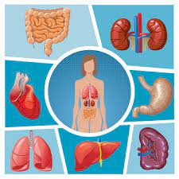
Introduction
Physiology is the science of life and as a branch, it aims at understanding the mechanisms of living things.
Physiology generally covers the basics of cell functions at ionic and molecular levels.
Physiology is much based on experimentation and thus it is an experimental science.
Human physiology gives more information on how the human body functions in health and in disease.
The selected topic to be explained in this presentation is the physiology and anatomy of the liver.
Notes:
According to Biga et al. (2020), physiology is the science of life and it aims at understanding the mechanisms of living things. Physiology generally covers the basics of cell functions at ionic and molecular levels and thus helps in understanding the behaviors of the whole body when influenced by the external environment. Physiology is much based on experimentation and thus it is an experimental science. Human physiology gives more information on how the human body functions in health and in disease (Biga et al., 2020). The selected topic to be explained in this presentation is the physiology and anatomy of the liver.

Slide 3
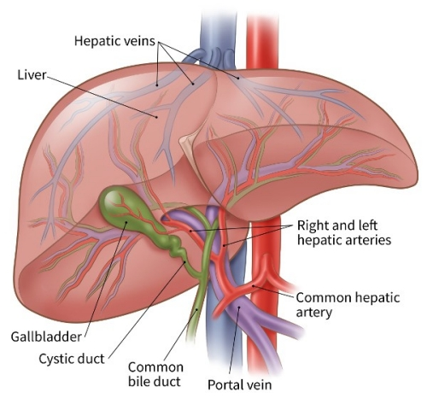
Basic Parts of the Liver
The liver is the second largest organ in the human body after the skin and is located in the upper right-hand portion of the abdominal cavity, beneath the diaphragm, and on top of the stomach.
The liver is divided into four chief lobes; the left lobe, right lobe, caudate lobe, and quadrate lobe.
The quadrate lobe is located on the inferior surface of the right lobe. The caudate lobe is located between the left and right lobes in an anterior and superior location.
The liver holds approximately one pint (13%) of the body’s blood supply at all times. The liver lobes have 8 segments that are subdivided into 1000-minute lobes and connect with each other to form the hepatic duct (Yang, 2021).
The main hepatic duct is responsible for transporting bile that is made in the liver cells to the gallbladder and then to the duodenum through the bile duct.
Notes:
The liver is the second largest organ in the human body after the skin and is located in the upper right-hand portion of the abdominal cavity, beneath the diaphragm, and on top of the stomach. The liver is divided into four chief lobes; the left lobe, right lobe, caudate lobe, and quadrate lobe (Yang, 2021). The quadrate lobe is located on the inferior surface of the right lobe. The caudate lobe is located between the left and right lobes in an anterior and superior location. The liver holds approximately one pint (13%) of the body’s blood supply at all times. The liver lobes have 8 segments that are subdivided into 1000-minute lobes and connect with each other to form the hepatic duct (Yang, 2021). The main hepatic duct is responsible for transporting bile that is made in the liver cells to the gallbladder and then to the duodenum through the bile duct.

Slide 4
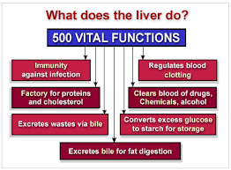
Functions of the Liver
The liver plays about 500 critical functions in animals and this makes it a very essential organ.
The liver is known for its ability to regulate most chemicals in the blood and this leads to the production of bile.
Through bile, the waste products are carried from the liver.
Blood from the small intestines and stomach enters the liver through the hepatic portal vein and the liver breaks down, balances, and creates nutrients.
There are drugs that humans consume need to be metabolized into simpler forms for the rest of the body and this is a function of the liver.
Notes:
The liver plays about 500 critical functions in animals and this makes it a very essential organ. This organ is known for its ability to regulate most chemicals in the blood and this leads to the production of bile. Through bile, the waste products are carried from the liver. Blood from the small intestines and stomach enters the liver through the hepatic portal vein and the liver breaks down, balances, and creates nutrients. There are drugs that humans consume need to be metabolized into simpler forms for the rest of the body and this is a function of the liver.

Slide 5
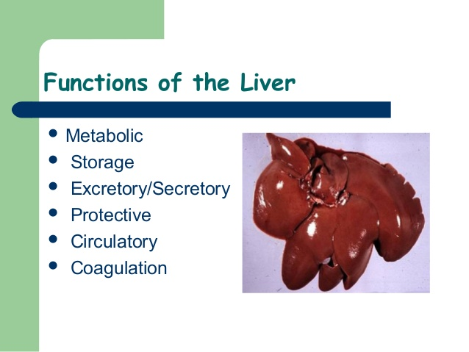
Continuation on Functions of the Liver
The liver acts as a storage location for fat-soluble vitamins and manages cholesterol homeostasis. Besides, iron and copper are essential minerals that are stored in the liver.
It plays the role of hematology with clotting factor and protein synthesis.
Heme is vital in the human body and the liver breaks it down into unconjugated bilirubin and makes it conjugated (Ritz et al., 2018).
The liver converts poisonous ammonia into urea which is the end product of protein metabolism and is excreted as urine.
Lastly, livers are known for blood detoxification through resisting disease, making immune factors and removing bacteria from the bloodstream.
Notes:
The liver acts as a storage location for fat-soluble vitamins and manages cholesterol homeostasis (Ritz et al., 2018). Besides, iron and copper are essential minerals that are stored in the liver. In addition, it plays the role of hematology with clotting factor and protein synthesis. Heme is vital in the human body and the liver breaks it down into unconjugated bilirubin and makes it conjugated (Yang, 2021). The liver also converts poisonous ammonia into urea which is the end product of protein metabolism and is excreted as urine. Lastly, livers are known for resisting disease through making immune factors and removing bacteria from the bloodstream.

Slide 6
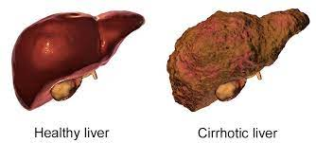
Common Liver infections That Affect its Physiology
There are many infections that affect the liver and the manner in which it functions.
The hepatitis infections, commonly hepatitis A, hepatitis B, and hepatitis C all caused by viruses (Yang, 2021).
Liver cirrhosis and fatty liver disease are caused by drugs, poisons, and too much alcohol. Many people have lost lives to liver cirrhosis.
Liver cancer is currently much pronounced and makes a person weak, exhausted, and lose weight. The infection leads to the accumulation of wastes in the human body (Yang, 2021).
The clinicians have realized that inherited diseases like hemochromatosis affect liver functioning and this might end up in liver failure hence death.
Notes:
There are many infections that affect the liver and the manner in which it functions; hepatitis infections, commonly hepatitis A, hepatitis B, and hepatitis C all caused by viruses limit the physiology of the organ. Besides, liver cirrhosis and fatty liver disease are caused by drugs, poisons, and too much alcohol (Yang, 2021). Many people have lost lives to liver cirrhosis. In addition, liver cancer is currently much pronounced and makes a person weak, exhausted, and lose weight. The infection leads to the accumulation of wastes in the human body. Clinicians have realized that inherited diseases like hemochromatosis affect liver functioning and this might end up in liver failure hence death.

Slide 7
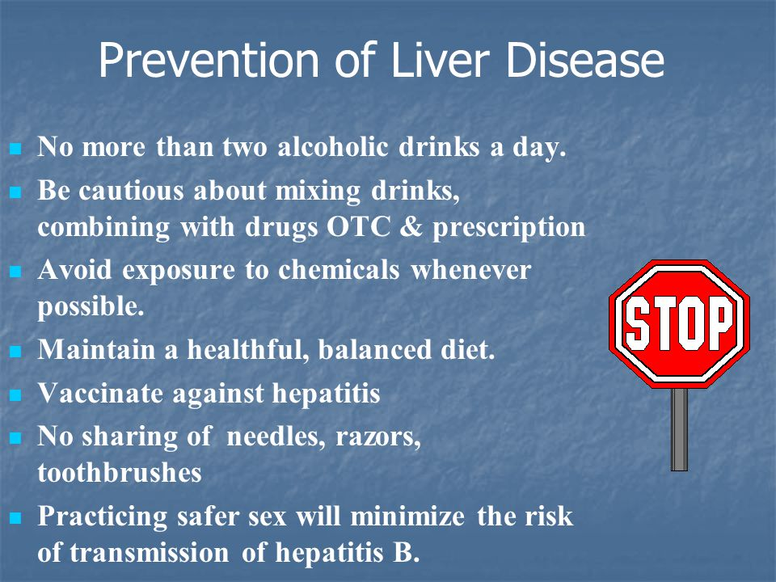
Conclusion
Having knowledge of physiology helps one to gain insight into the complex nature of the human body and know better ways of keeping the body healthy.
Liver infections and dangerous and in most cases terminal and thus preventing them might be easier than curing them.
For effective physiology of the human liver, people should limit alcohol consumption, keep in exercising, eat safe foods, use safe medicines and limit contact with other people’s body fluids including blood.
Notes:
Having knowledge of physiology helps one to gain insight into the complex nature of the human body and know better ways of keeping the body healthy. Without a comprehensive knowledge of physiology, the clinicians might not be able to evaluate the health status of patients (John Hopkins, 2019). Liver infections and dangerous and in most cases terminal and thus preventing them might be easier than curing them. For effective physiology of the human liver, people should limit alcohol consumption, keep in exercising, eat safe foods, use safe medicines and limit contact with other people’s body fluids including blood.

Slide 8
References
Biga, L. M., Dawson, S., Harwell, A., Hopkins, R., Kaufmann, J., LeMaster, M., ... & Runyeon, J. (2020). Anatomy & physiology.
John Hopkins. (2019). Liver; Anatomy and Functions. Retrieved from https://www.hopkinsmedicine.org/health/conditions-and-diseases/liver-anatomy-and-functions#:~:text=Anatomy%20of%20the%20liver,that%20weighs%20about%203%20pounds.
Ritz, T., Krenkel, O., & Tacke, F. (2018). Dynamic plasticity of macrophage functions in diseased liver. Cellular immunology, 330, 175-182.
Yang, L. L. (2021). Anatomy and Physiology of the Liver. In Anesthesia for Hepatico-Pancreatic-Biliary Surgery and Transplantation (pp. 15-40). Springer, Cham.

